Slide 1
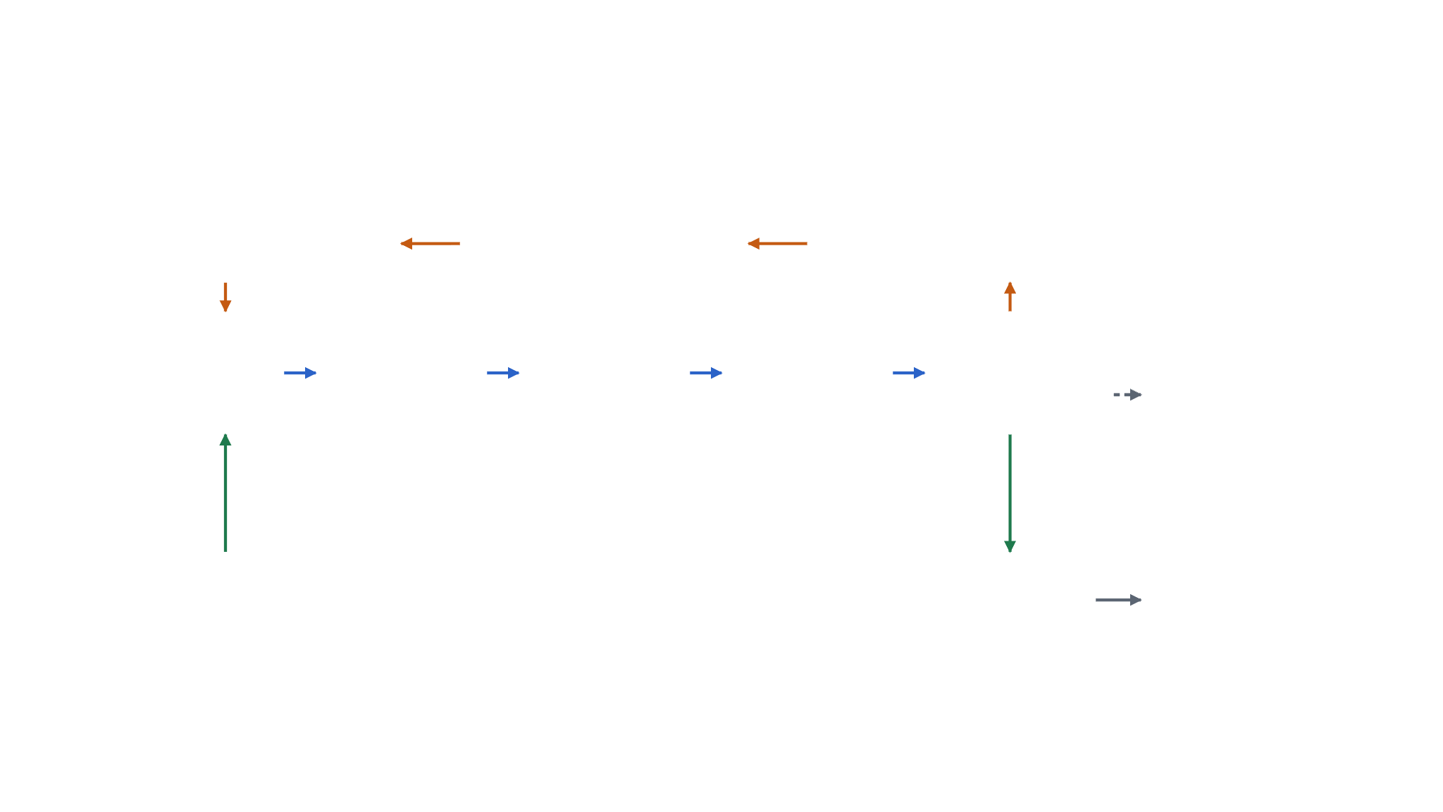
Two loops, one memory: the harness architecture
X LOOP · ON PLATEAU, THE HARNESS REWRITES ITSELF
AWS EC2
Version + evaluate
Rewrite harness
Detect plateau
Runs Tier 2 in Docker, many in parallel
harness_versions
LLM via OpenRouter
Python · trial stats
Agent edits RTL
Testbench gate
Tier 1 synth
Tier 2 P&R
Score
LangSmith
Yosys · seconds
OpenROAD · minutes
fmax, gated on DRC = 0
Traces every LLM call: proof the harness changed its reasoning
LangGraph · OpenRouter
Icarus Verilog
Y LOOP · EVERY TRIAL: EDIT → VERIFY → MEASURE
MONGODB ATLAS · MEMORY, STATE, LINEAGE
Vercel
lessons
checkpoints
harness_versions
trials
Next.js dashboard on Atlas: fmax by generation
Vector Search recall of past fixes
crash-safe suspend + resume
config, diff, lineage
every attempt + its metrics
Notes:
Inner Y loop (blue): every trial, the agent edits Verilog, a testbench gates correctness, Yosys gives a seconds-fast estimate, and OpenROAD gives the real frequency. Outer X loop (orange): when scores stop improving, the harness rewrites its own config, versions it, and hands it back to the agent. MongoDB Atlas (green) holds everything: trials, harness versions with lineage, retrievable lessons, and LangGraph checkpoints. Right column: where it runs (EC2), how we prove it (LangSmith), and how judges see it (Vercel).

Slide 2
What each piece does, and what it enables
Technology | Does | Enables
MongoDB Atlas + Vector Search | Stores trials, harness versions, lessons, checkpoints | Memory across hundreds of runs, full lineage, crash-safe resume, recall of similar past fixes
LangGraph | Runs both loops as one state graph | Clean plateau → rewrite hand-off; state checkpointed to Atlas
OpenRouter | One API to many models | A model per loop; swap or compare models without code changes
Icarus Verilog + Yosys | Testbench gate, then synthesis in seconds | Fast-but-wrong designs score zero; a cheap filter before slow runs
OpenROAD on AWS EC2 | Full place and route (Nangate45) in Docker, in parallel | Hard metrics (fmax, DRC) at dozens of runs per hour
LangSmith | Traces every LLM call | Evidence of how the harness changed its own reasoning
Vercel + Next.js | Dashboard over Atlas | Public demo link; fmax-by-generation chart and harness diffs
Notes:
Read the right column: each choice is there because of what it unlocks. Atlas is required to be a finalist, and it is also what makes the harness remember and evolve. The testbench gate is the anti-reward-hacking guardrail.

